Slide 1
Predicate Logic

Slide 2
Limitation of Propositional Logic
Let p: All Students should take CS courses
Let q: Melissa is a student
q is a proposition. But p is not, because it generalizes. It is not possible to express in Propositional Logic. Proposition should be very specific with no variables or generalizations.
We need Predicate Logic
What is Predicate Logic then.

Slide 3
A predicate is a statement that contains variables
They may be true or false depending on the values of these variables
x > 10 is a predicate because it has a variable x
but is it : True or False ?
Let x be 11
Then x > 10 is true.
So a statement with variables can be True or False when we assign values to the variables

Slide 4
A predicate can be expressed as P(x)
P(x ) could be x³ > x . It is Predicate
P(1) is 1³ > 1 is a Proposition, it is false though.
P(2) is 2³ > 1 is a true proposition

Slide 5
We now know predicate takes a value of a variable. Once a value is assigned to the variable, the predicate becomes a proposition.
Additionally, we have to specify explicitly the domain of the predicate
In other words, the boundaries of the predicate need to be specified.
We call it domain of the predicate variable
set Z of all integers, set N of all natural numbers

Slide 6
When more than one predicate variables are involved, variables may have their own domain or common domain
P ( x, y ) : x > y is a predicate
P ( 4, 2 ) : 4 > 2 is true and is a proposition
P ( 2, 4) : 2 > 4 is false , and is a proposition
P ( 4, 2 ) is not equal to P ( 2, 4) , so the variables are not interchangeable.

Slide 7
Two type of Quantifiers
For all - the universal quantification
There exists - existential quantification

Slide 8
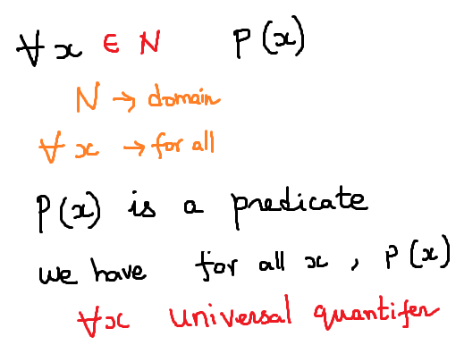
Universal Quantifiers

Slide 9
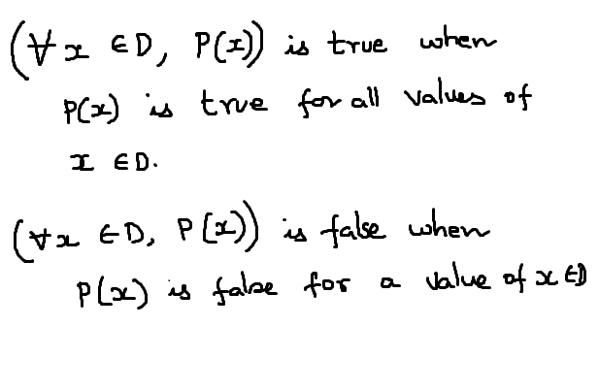

Slide 10
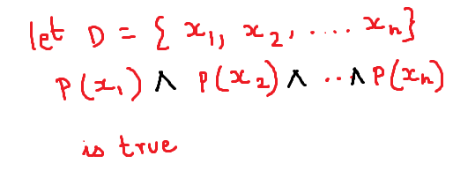

Slide 11
Existential Quantifier
An existential quantification is a quantifier meaning there exists
There exists a prime number whose cube is less than 10

Slide 12
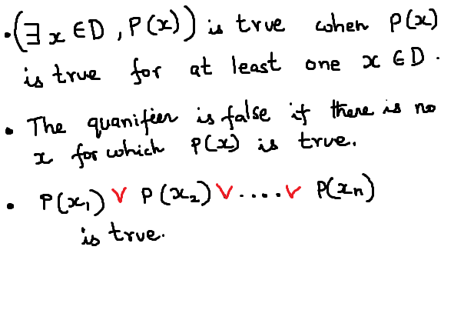

Slide 13
